Slide 1
Ecommerce for movies
Jacob Ford, Kirk Kratohvil, Jordan Simmons

Slide 2
Product Details
details: {
title: "Dude, Where's My Car?",
genre: [ "Mystery", "Science"],
length: "1h 23m",
rating: "7.9/10",
year: 2000,
aspect_ratio: "16:9" } });

Slide 3
Pricing
pricing: {
list: 12.00,
retail: 11.00,
savings: 1.00,
pct_savings: 8 },

Slide 4
Shipping
shipping: {
weight: "13oz",
dimensions: {
width: "190mm",
height: "133mm" }

Slide 5
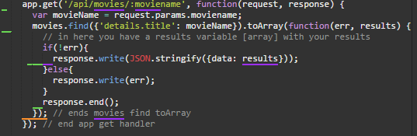
GET

Slide 6
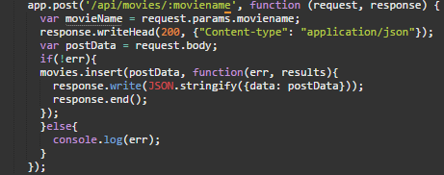
POST

Slide 7
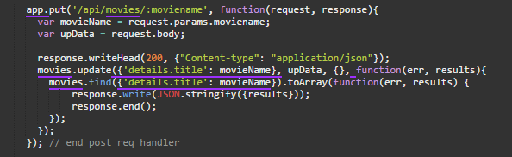
PUT

Slide 8
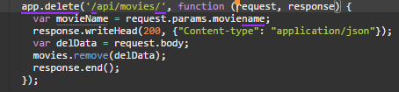
Delete

